Slide 1



Literacy in Year 5
Reading
Writing (including Spelling)
Talking & Listening
Notes:
1

Slide 2
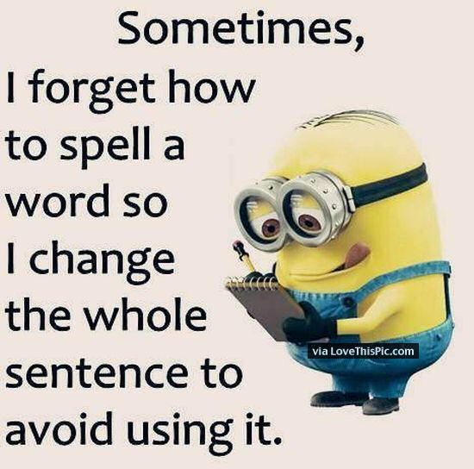
Spellings
Spelling is a key focus this year in
school. Pupils will be expected to complete
their spellings each evening, along with a weekly spelling task. Your child’s weekly spelling list is a combination of phonics, topic words and high frequency words.
Some strategies/activities to use at home:
Look-Say-Cover-Write- Check
Pyramid words
Rainbow strategy
Silly sentences
All pupils are encouraged to ‘HAVE A GO’ when spelling new words and to sound it out!
Notes:
2

Slide 3
READING AT HOME
SOME TIPS:
Encourage your child to read from a variety of sources
Let your child see you reading
Explore print in the environment
Encourage your child to try new books, not just those by a favourite author
Try to find time to read to your child and with them
What if my child doesn’t
enjoy reading?

Slide 4
Developing Reading Comprehension
The types of questions to ask:
Answers directly from the text
e.g. What was the dog called?
Searching for clues to back up an answer
e.g. How do you know that Mr Brown was clever?
Encouraging personal response to text and using evidence to support point of view
e.g. What do you think the shopkeeper is thinking and why do you think this?

Slide 5


